Slide 1



Pioneers
PAYROLL PROCESSING AND MANAGEMENT
IN
ORACLE ERP
NXT23_ONL2_ERP2_G1
Supervised by ENG\Hassan Amgad
Team: PIONEERS

Slide 2


PIONEERS TEAM
Azza Abdallah
Hadeer Aboelnasr
Aya Sleem
Marwa Adel
Jihad Nour

Slide 3




ABSTRACT
At Pioneers, managing payroll has become more difficult as the company grows. Manual processing often leads to errors, delayed payments, and challenges with tax and labor law compliance. These issues not only affect employees but also slow down operations.
To solve this, we introduce Oracle Payroll, a system that automates the entire payroll process. It handles everything from setting up payroll elements and processing salaries to generating reports and ensuring compliance.
Our goal is to implement a payroll system that is accurate, fast, and reliable—reducing errors, improving efficiency, and keeping employees satisfied.

Slide 4






PHASES IMPLEMENTATION & TASK DIVISION
Phase 1 : Payroll Configuration and Employee Setup
Hadeer Aboelnasr & Aya Sleem
Phase 2: Payroll Processing and Adjustments
Marwa Adel & JihadNour
Phase 3: Payroll Reconciliation and Reporting
Azza Abdallah

Slide 5


PHASE ONE
PAYROLL CONFIGURATION AND EMPLOYEE SETUP
1. Define Payroll Elements.
2. Set up Employee Payment Methods.
3. Payroll calendar.
4. Update Employee Records.

Slide 6

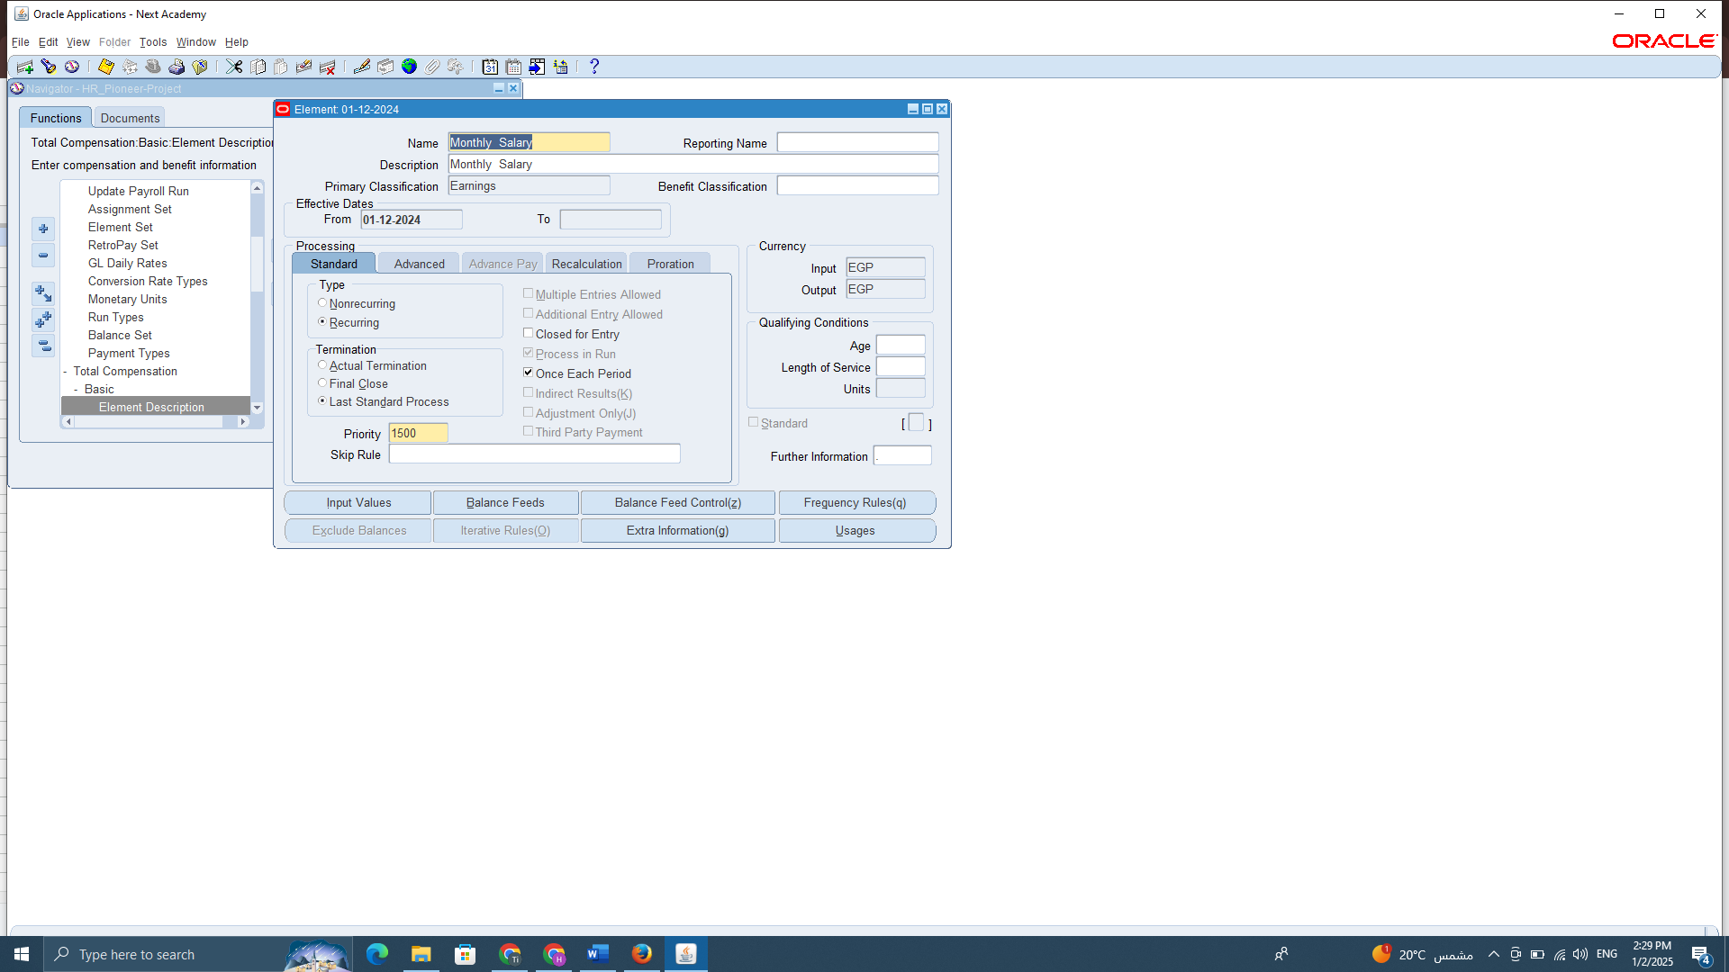
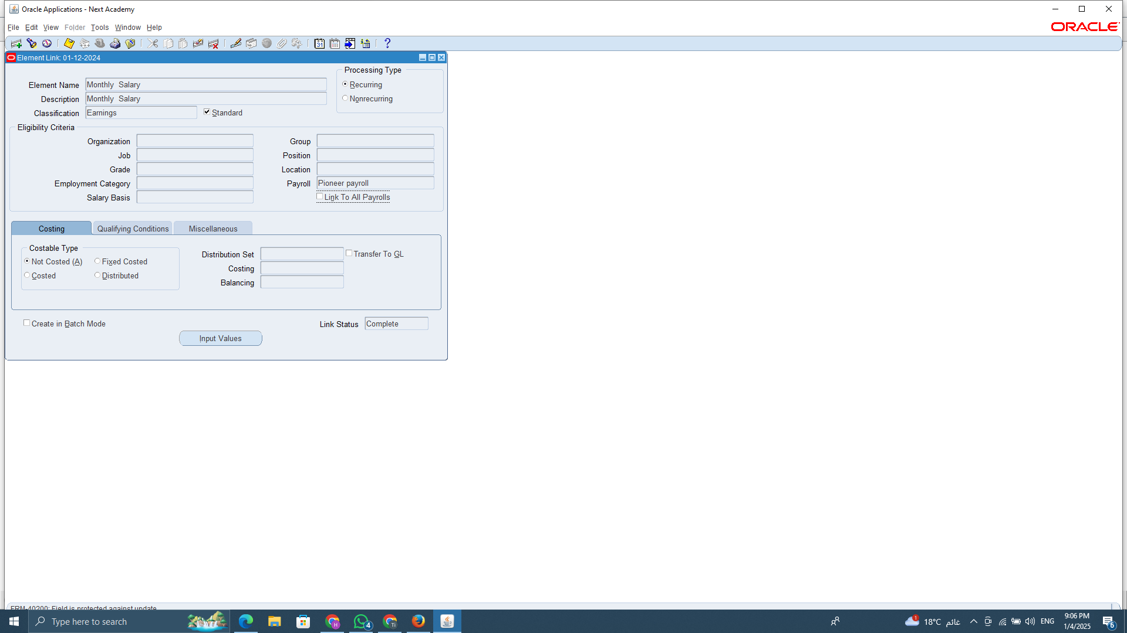
1. DEFINE PAYROLL ELEMENTS
Payroll elements are the core components of a payroll system, representing different types of earnings, deductions, and allowances that form an employee’s compensation. These elements are customized to match company policies, ensuring accurate salary calculations and compliance with legal and financial regulations.
Element Name: Monthly Salary.
Element Type: Earnings - Recurring – Standard.
Element Link: All Payroll Group.
Element Set: Monthly Payroll.

Slide 7

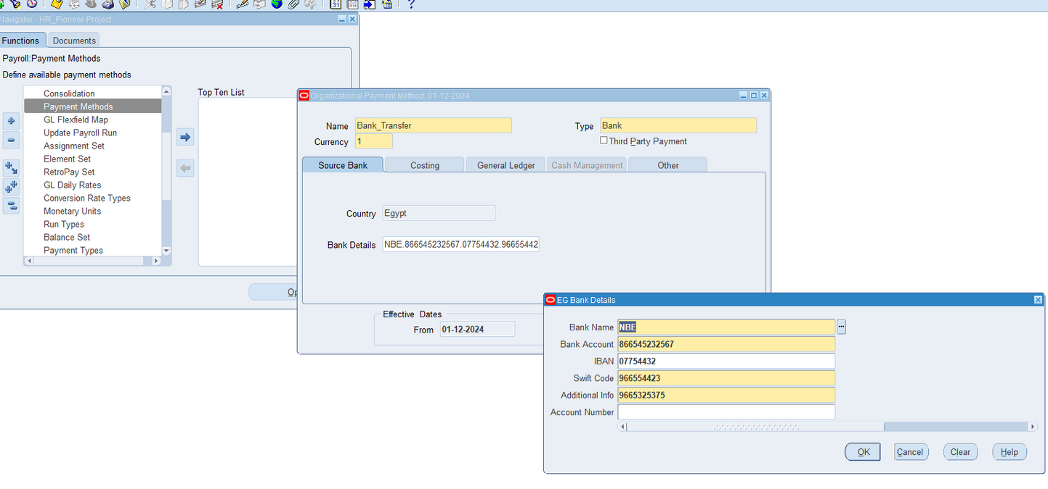
2. SET UP EMPLOYEE PAYMENT METHODS
Bank Transfer is a payment method that allows for the direct transfer of funds from an employer's account to an employee's bank account. This method is widely used for payroll disbursements, offering a secure and efficient way to pay employees without the need for paper checks.
Payment Methods Name: Bank Transfer.
Payment Methods Type: Bank .
Currency: EGY.
Bank Details: (Bank Name - Bank Account - Swift Code - IBAN- Additional Info - Account Number).

Slide 8

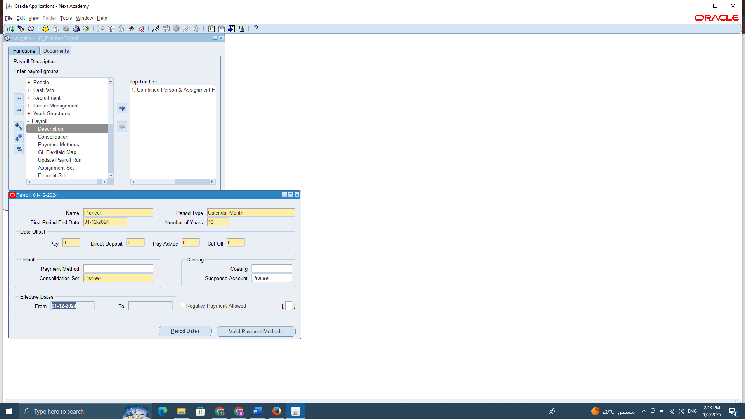
3. THE PAYROLL CALENDAR
The payroll calendar is a crucial component of payroll management, as it defines the pay periods and establishes
a structured schedule for salary disbursement. By configuring the payroll calendar, organizations can determine whether employees are paid weekly, bi-weekly, or monthly.
Calendar Name : Pioneer
Calendar Type: Monthly
Number Of Years: 10

Slide 9

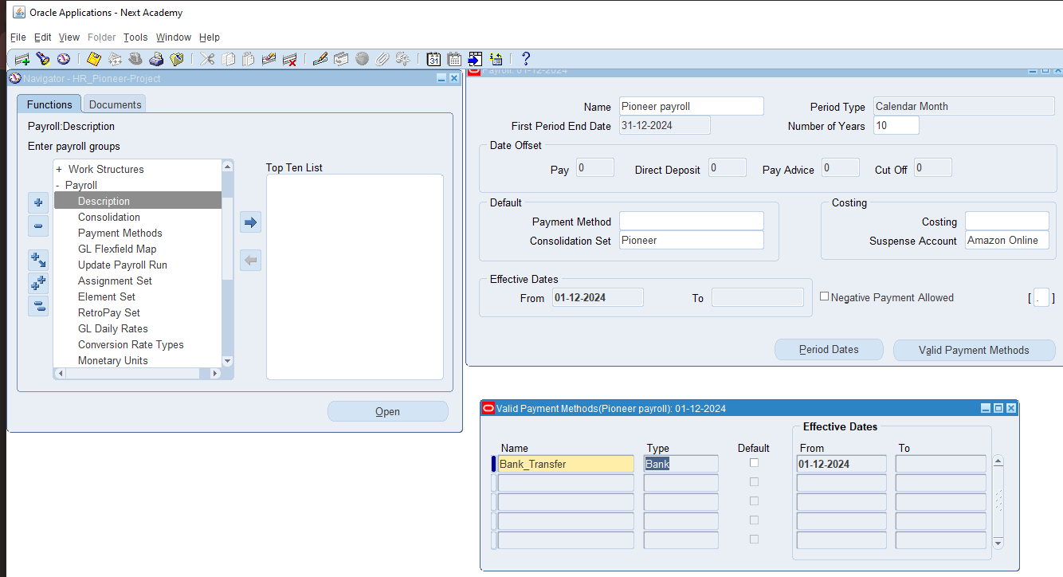
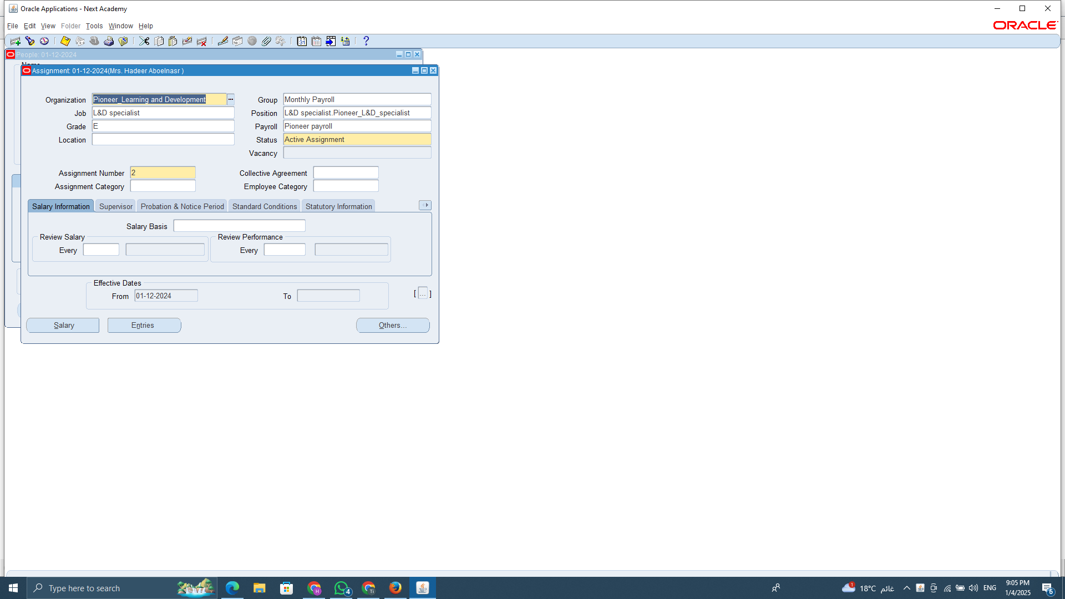

Link Payment Method With Payroll Calendar
By linking payment methods, the system ensures that employee salaries are deposited accurately and on time whether through direct deposit, bank transfers, or checks according to the payroll calendar.
Linking the payroll calendar ensures that each employee’s pay period and pay date are correctly assigned.
This connection allows the system to determine when salaries should be processed and disbursed based on the defined payroll schedule.

Slide 10
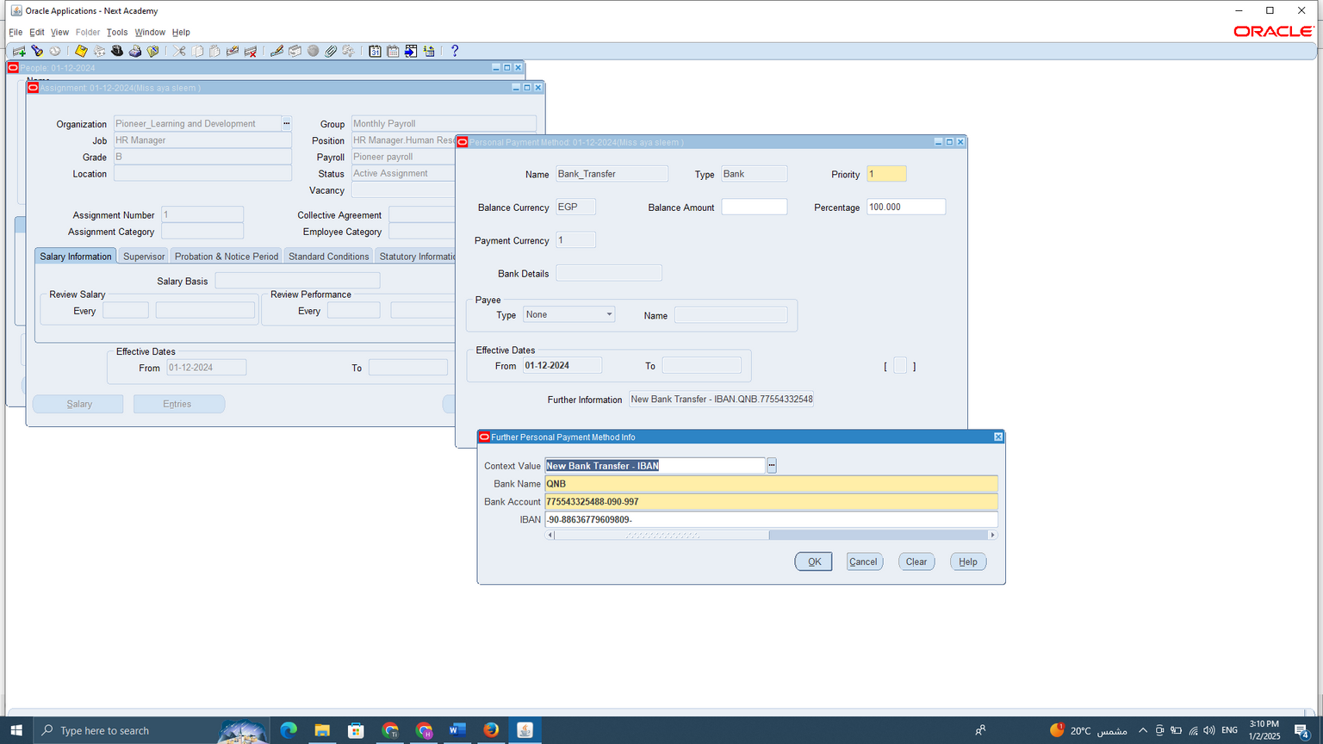
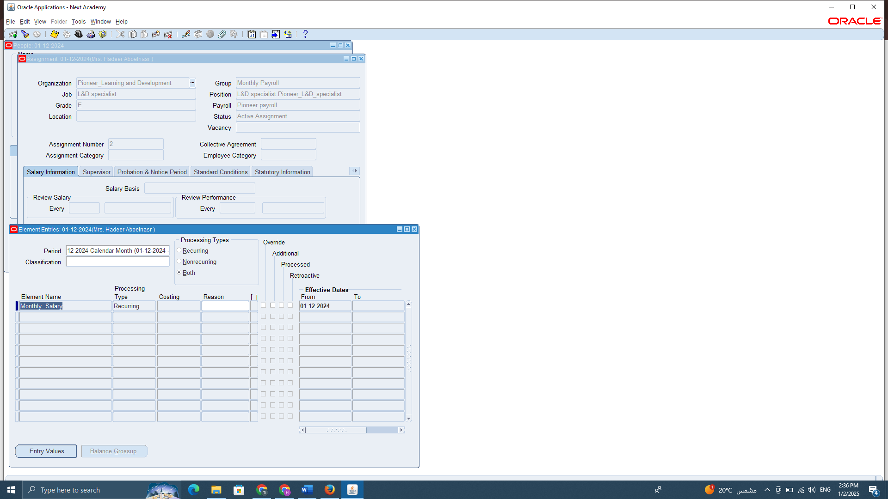
4. UPDATE EMPLOYEE RECORDS
Update Employee Record with Payment Method.
Adding payroll items (earnings, deductions, and allowances) to each employee’s profile.

Slide 11



PHASE TWO
PAYROLL PROCESSING AND ADJUSTMENTS
1. Payroll processed (Payroll Run).
2. Quick Pay Runs.
3. Manage Adjustments and corrections Handled.
4. Bank Transfer and Payments.

